Slide 1
A/B Testing
Slightly more than just A and B

Slide 2
Agenda
Why do we need AB Testing?

Slide 3
Why bother with A/B Testing?

Slide 4

Scenario 1
You made a web design change to attract users to click 安心訂購
Launched it on Mar 1st
Job done!
Work on the next change.
What is wrong here?

Slide 5
“It is not a big change…”

Slide 6
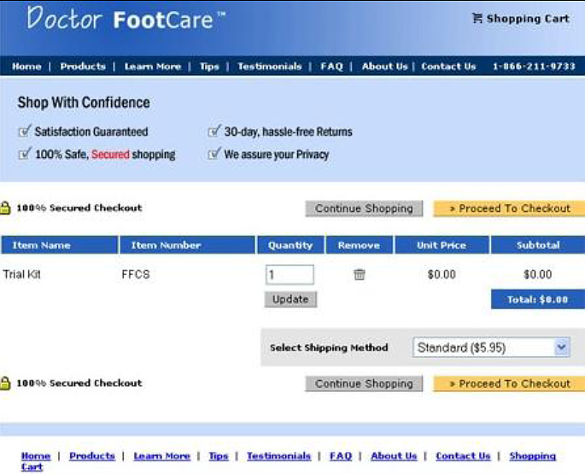
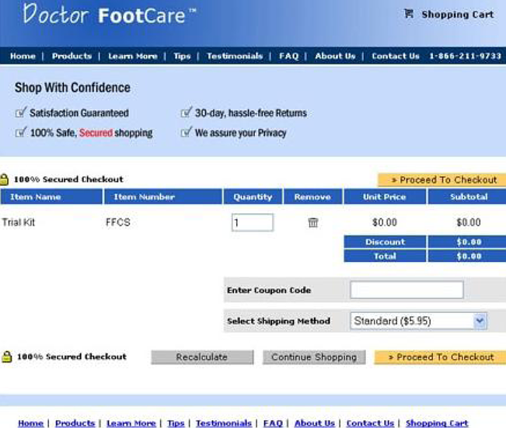
It is not a big change…
Revenue dropped by 90%

Slide 7
Scenario 2
You made a web design change to attract users to click 安心訂購
Launched it on Mar 1st
Monitor the daily click rate for one week
Mar 8th : daily rate increased by 5%
The design change is good. Declare victory! ☺
What could be wrong?

Slide 8
Possible factors
Seasonal changes (e.g. Christmas, Valentine’s Day)
Promotion from vendors
Promotion from Price.com.hk
Pure luck

Slide 9
Ok. Then let’s do A/B Testing

Slide 10
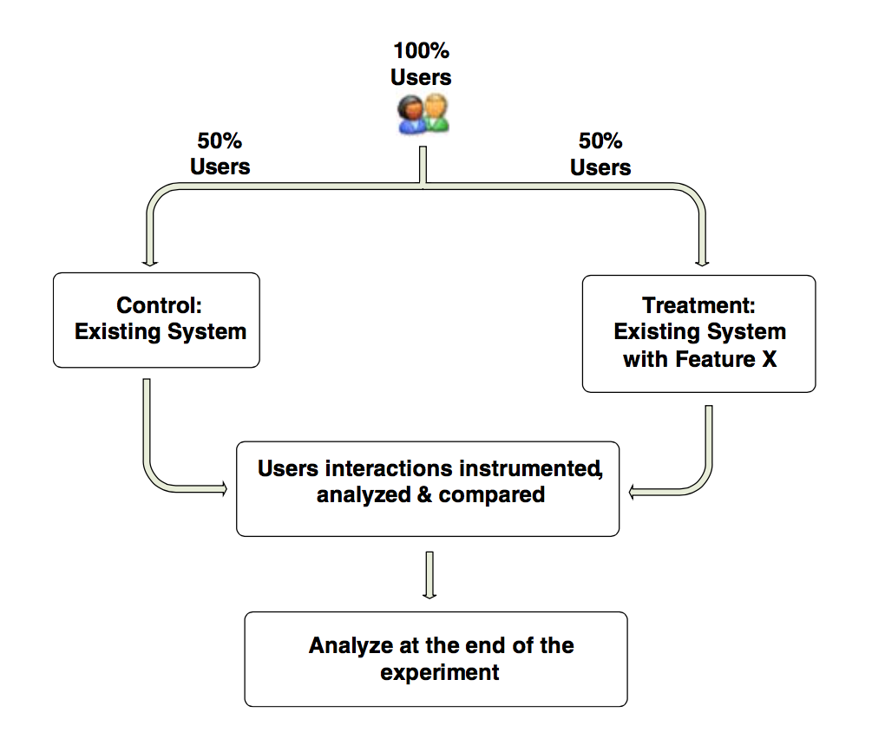
High-level flow for an A/B Test

Slide 11
Scenario 3
You made a web design change to attract users to click 安心訂購
Launch an A/B Testing on Mar 1st
Collect data for one day
Measure total number of clicks
Result:
A: 300
B: 330
10% increase. Declare victory! ☺
What could be wrong?

Slide 12
What could go wrong?
Assume:
Size of group A = 1000
Probability of clicking = 0.03
Size of group B: 1000
But:
We have a bug in code
Group B users actually see the same thing
Probability of clicking = 0.03
Let’s do a simulation ☺

Slide 13
What could go wrong?
Size of group A = Size of group B = 1000
Same probability: 0.03
In our simulation:
If you do the same A/B Test 10,000 times…
~1/3 of the time you can B wins by ten percent
Increase size of each group to 10,000: ~1/3 → 12%
The question: Is the difference statistically significant? (translated: how lucky were you?)

Slide 14
But what should we measure?

Slide 15
Overall Evaluation Criterion (OEC)
Also called Key Performance Indicator (KPI)
Sometimes it’s easy.
E.g.
Conversion rate at registration page
Clicks generated by the product page
Sometimes it’s tricky
Any example?

Slide 16
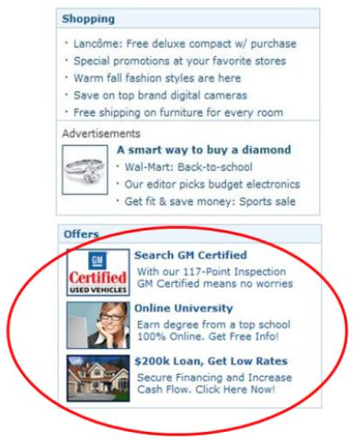
MSN Home Page: Special Offers
MSN wanted to add an Offers widget on the homepage
Estimated good revenue from it.
Obvious OEC:
Revenue generated from these offers
What’s missing?
Impact on user experience
But how to measure “user experience”?
Measure impact on:
Homepage PV on homepage
No of Clicks from homepage
Assign monetary value to each one

Slide 17
Overall Evaluation Criterion (OEC)
Must be agreed upon before the experiment
Must be measureable
Short-term gain vs. Long-term gain

Slide 18
Other thing to watch out

Slide 19
Delayed response time
Feature change, A/B Test, OEC is PV of that page
Result: B generates 5% less PV
Reason?
#1: Users don’t like the new feature
#2: B is slower (e.g. on average takes 10ms longer to render)
One solution:
A/B/A’ Test
B and A’ will have the same performance

Slide 21
Summary

